Slide 1
Chapter 3: Processes
Notes:
‹#›

Slide 2
Chapter 3: Processes
Process Concept
Process Scheduling
Operations on Processes
Interprocess Communication
Examples of IPC Systems
Communication in Client-Server Systems

Slide 3
Objectives
To introduce the notion of a process -- a program in execution, which forms the basis of all computation
To describe the various features of processes, including scheduling, creation and termination, and communication
To explore interprocess communication using shared memory and message passing
To describe communication in client-server systems

Slide 4
Process Concept
An operating system executes a variety of programs:
Batch system – jobs
Time-shared systems – user programs or tasks
Textbook uses the terms job and process almost interchangeably
Process – a program in execution; process execution must progress in sequential fashion
Multiple parts
The program code, also called text section
Current activity including program counter, processor registers
Stack containing temporary data
Function parameters, return addresses, local variables
Data section containing global variables
Heap containing memory dynamically allocated during run time

Slide 5
Process Concept (Cont.)
Program is passive entity stored on disk (executable file), process is active
Program becomes process when executable file loaded into memory
Execution of program started via GUI mouse clicks, command line entry of its name, etc
One program can be several processes
Consider multiple users executing the same program

Slide 6
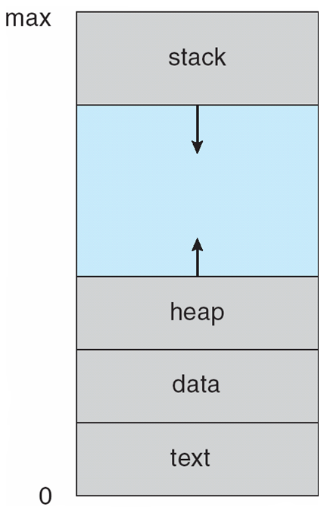
Process in Memory

Slide 7
Process State
As a process executes, it changes state
new: The process is being created
running: Instructions are being executed
waiting: The process is waiting for some event to occur
ready: The process is waiting to be assigned to a processor
terminated: The process has finished execution

Slide 8
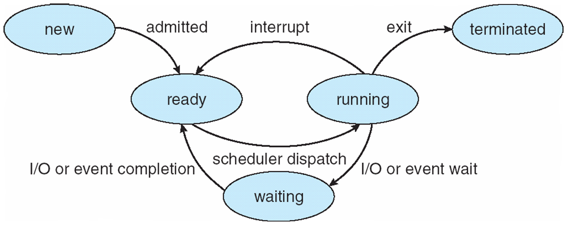
Diagram of Process State

Slide 9
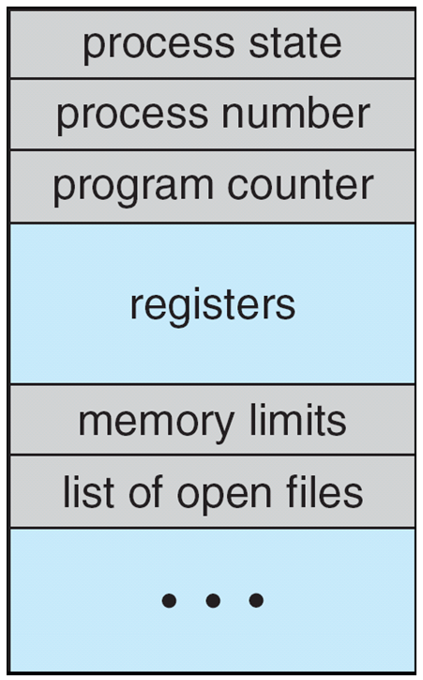
Process Control Block (PCB)
Information associated with each process
(also called task control block)
Process state – running, waiting, etc
Program counter – location of instruction to next execute
CPU registers – contents of all process-centric registers
CPU scheduling information- priorities, scheduling queue pointers
Memory-management information – memory allocated to the process
Accounting information – CPU used, clock time elapsed since start, time limits
I/O status information – I/O devices allocated to process, list of open files

Slide 10
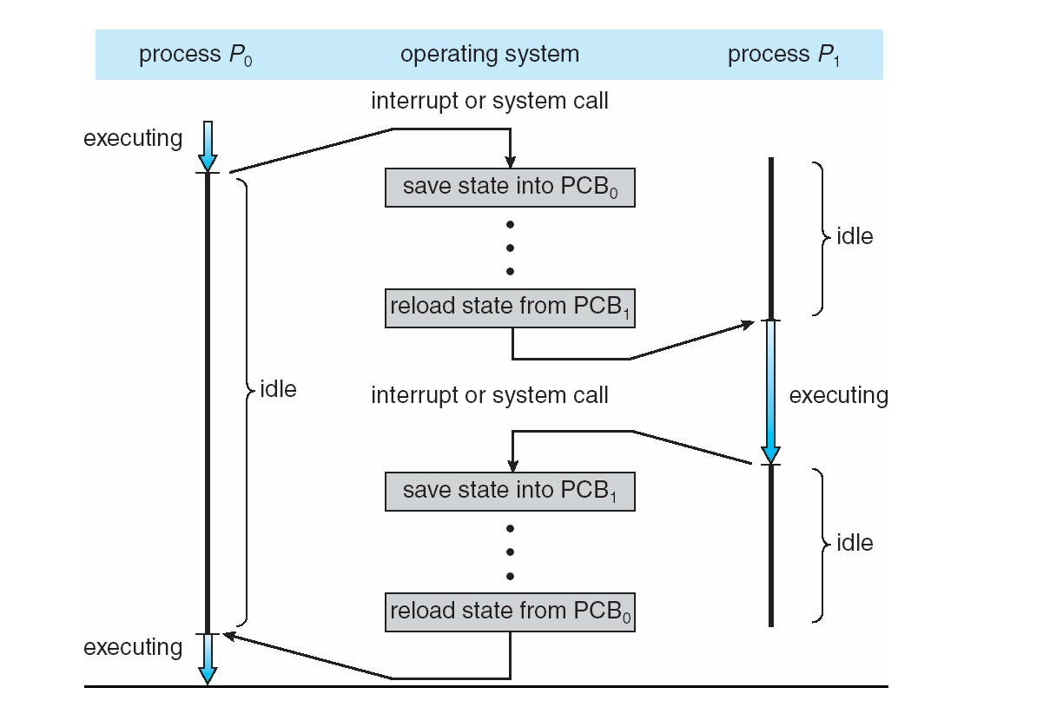
CPU Switch From Process to Process

Slide 11
Threads
So far, process has a single thread of execution
Consider having multiple program counters per process
Multiple locations can execute at once
Multiple threads of control -> threads
Must then have storage for thread details, multiple program counters in PCB
See next chapter

Slide 12
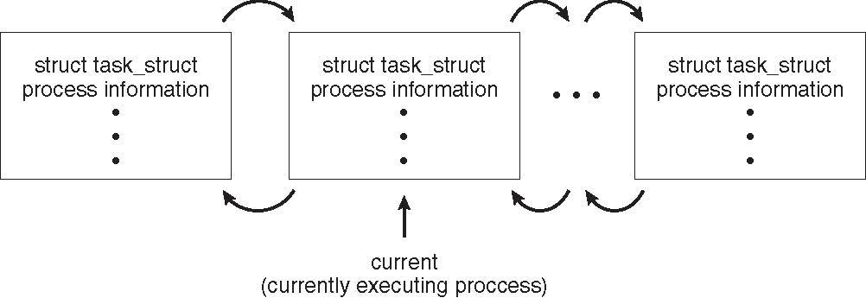
Process Representation in Linux
Represented by the C structure task_struct
pid t_pid; /* process identifier */ long state; /* state of the process */ unsigned int time_slice /* scheduling information */ struct task_struct *parent; /* this process’s parent */ struct list_head children; /* this process’s children */ struct files_struct *files; /* list of open files */ struct mm_struct *mm; /* address space of this process */

Slide 13
Process Scheduling
Maximize CPU use, quickly switch processes onto CPU for time sharing
Process scheduler selects among available processes for next execution on CPU
Maintains scheduling queues of processes
Job queue – set of all processes in the system
Ready queue – set of all processes residing in main memory, ready and waiting to execute
Device queues – set of processes waiting for an I/O device
Processes migrate among the various queues

Slide 14
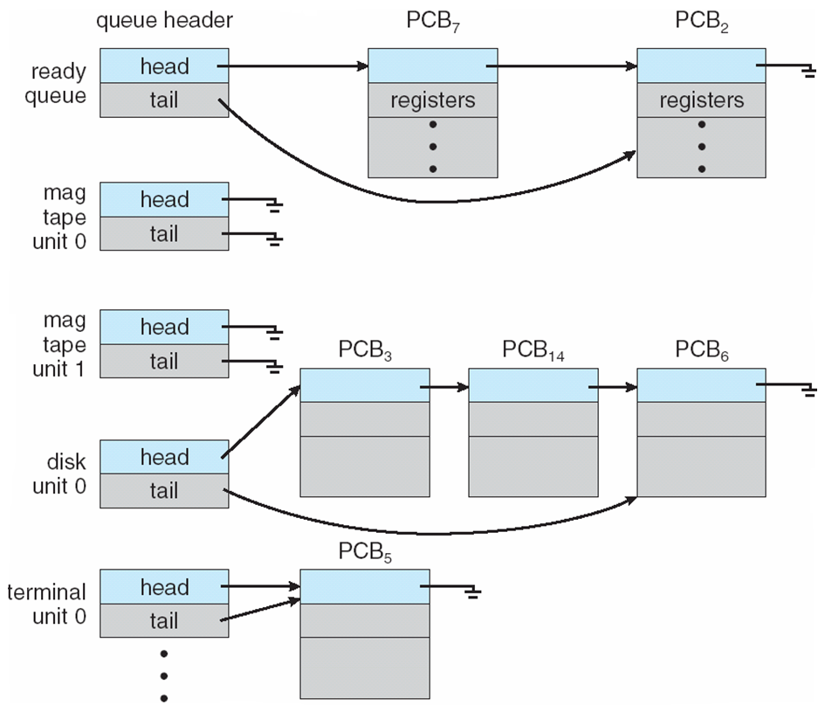
Ready Queue And Various I/O Device Queues

Slide 15
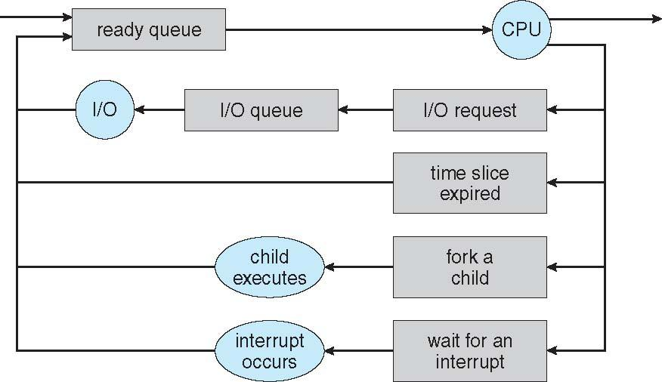
Representation of Process Scheduling
Queueing diagram represents queues, resources, flows

Slide 16
Schedulers
Short-term scheduler (or CPU scheduler) – selects which process should be executed next and allocates CPU
Sometimes the only scheduler in a system
Short-term scheduler is invoked frequently (milliseconds) ⇒ (must be fast)
Long-term scheduler (or job scheduler) – selects which processes should be brought into the ready queue
Long-term scheduler is invoked infrequently (seconds, minutes) ⇒ (may be slow)
The long-term scheduler controls the degree of multiprogramming
Processes can be described as either:
I/O-bound process – spends more time doing I/O than computations, many short CPU bursts
CPU-bound process – spends more time doing computations; few very long CPU bursts
Long-term scheduler strives for good process mix

Slide 17
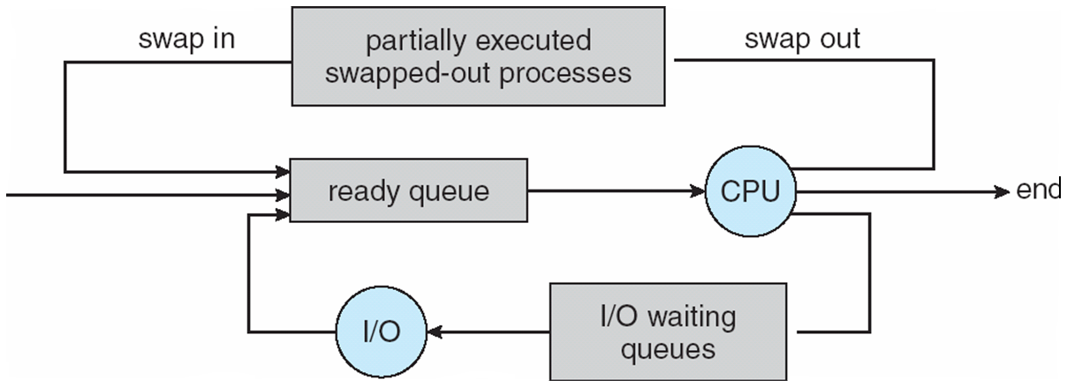
Addition of Medium Term Scheduling
Medium-term scheduler can be added if degree of multiple programming needs to decrease
Remove process from memory, store on disk, bring back in from disk to continue execution: swapping

Slide 18
Multitasking in Mobile Systems
Some mobile systems (e.g., early version of iOS) allow only one process to run, others suspended
Due to screen real estate, user interface limits iOS provides for a
Single foreground process- controlled via user interface
Multiple background processes– in memory, running, but not on the display, and with limits
Limits include single, short task, receiving notification of events, specific long-running tasks like audio playback
Android runs foreground and background, with fewer limits
Background process uses a service to perform tasks
Service can keep running even if background process is suspended
Service has no user interface, small memory use

Slide 19
Context Switch
When CPU switches to another process, the system must save the state of the old process and load the saved state for the new process via a context switch
Context of a process represented in the PCB
Context-switch time is overhead; the system does no useful work while switching
The more complex the OS and the PCB 🡺 the longer the context switch
Time dependent on hardware support
Some hardware provides multiple sets of registers per CPU 🡺 multiple contexts loaded at once

Slide 20
Operations on Processes
System must provide mechanisms for:
process creation,
process termination,
and so on as detailed next

Slide 21
Process Creation
Parent process create children processes, which, in turn create other processes, forming a tree of processes
Generally, process identified and managed via a process identifier (pid)
Resource sharing options
Parent and children share all resources
Children share subset of parent’s resources
Parent and child share no resources
Execution options
Parent and children execute concurrently
Parent waits until children terminate

Slide 22
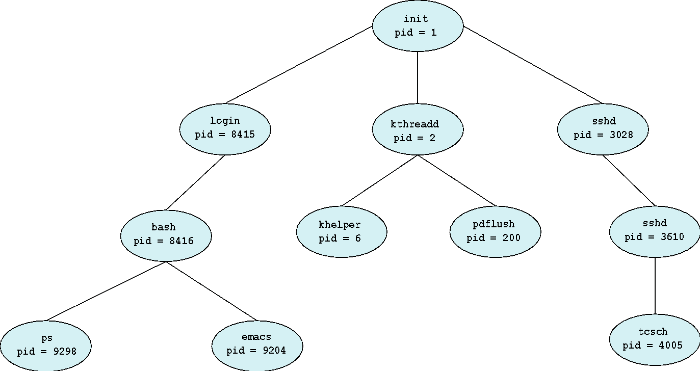
A Tree of Processes in Linux

Slide 23
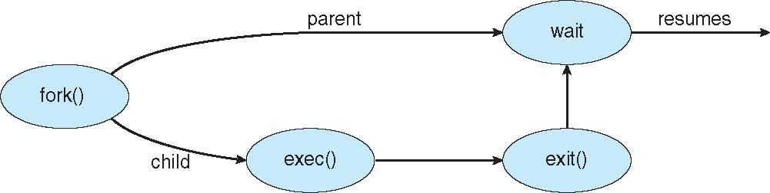
Process Creation (Cont.)
Address space
Child duplicate of parent
Child has a program loaded into it
UNIX examples
fork() system call creates new process
exec() system call used after a fork() to replace the process’ memory space with a new program

Slide 24
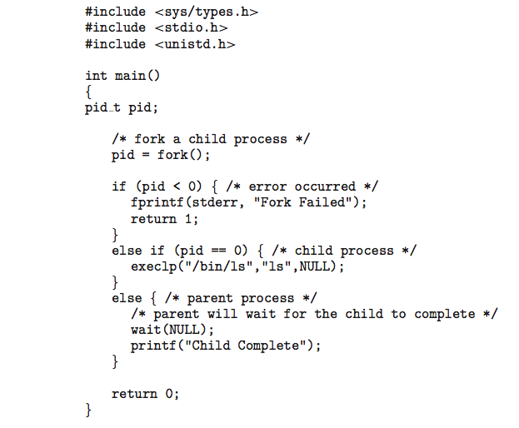
C Program Forking Separate Process

Slide 25
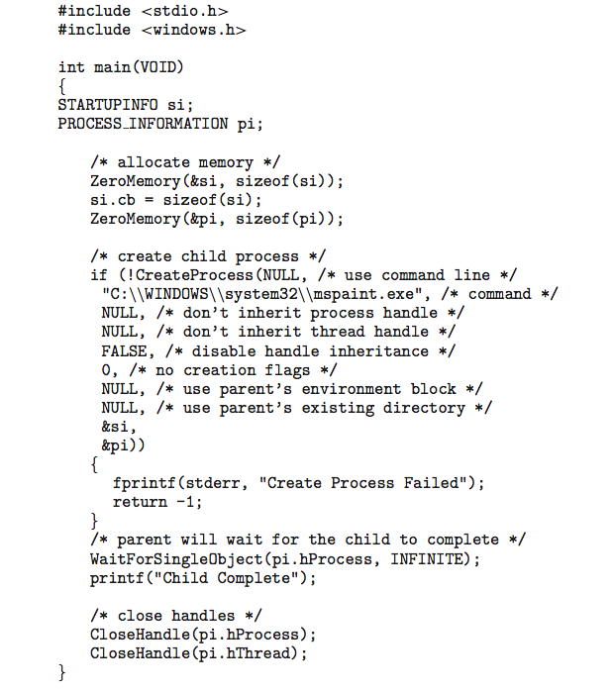
Creating a Separate Process via Windows API

Slide 26
Process Termination
Process executes last statement and then asks the operating system to delete it using the exit() system call.
Returns status data from child to parent (via wait())
Process’ resources are deallocated by operating system
Parent may terminate the execution of children processes using the abort() system call. Some reasons for doing so:
Child has exceeded allocated resources
Task assigned to child is no longer required
The parent is exiting and the operating systems does not allow a child to continue if its parent terminates

Slide 27
Process Termination
Some operating systems do not allow child to exists if its parent has terminated. If a process terminates, then all its children must also be terminated.
cascading termination. All children, grandchildren, etc. are terminated.
The termination is initiated by the operating system.
The parent process may wait for termination of a child process by using the wait()system call. The call returns status information and the pid of the terminated process
pid = wait(&status);
If no parent waiting (did not invoke wait()) process is a zombie
If parent terminated without invoking wait , process is an orphan

Slide 28

Multiprocess Architecture – Chrome Browser
Many web browsers ran as single process (some still do)
If one web site causes trouble, entire browser can hang or crash
Google Chrome Browser is multiprocess with 3 different types of processes:
Browser process manages user interface, disk and network I/O
Renderer process renders web pages, deals with HTML, Javascript. A new renderer created for each website opened
Runs in sandbox restricting disk and network I/O, minimizing effect of security exploits
Plug-in process for each type of plug-in

Slide 29
Interprocess Communication
Processes within a system may be independent or cooperating
Cooperating process can affect or be affected by other processes, including sharing data
Reasons for cooperating processes:
Information sharing
Computation speedup
Modularity
Convenience
Cooperating processes need interprocess communication (IPC)
Two models of IPC
Shared memory
Message passing

Slide 30
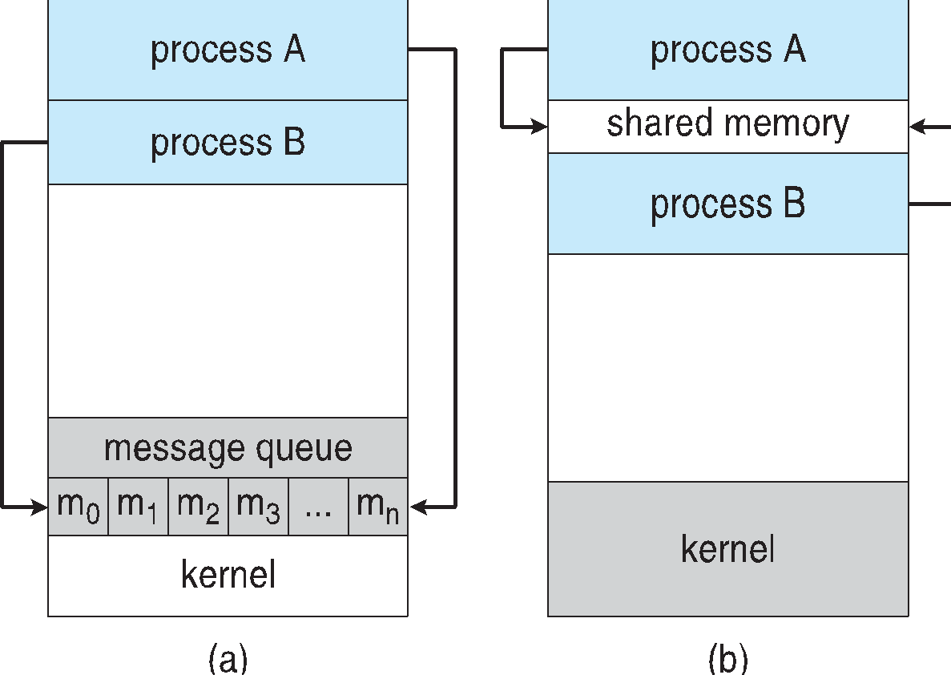
Communications Models
(a) Message passing. (b) shared memory.

Slide 31
Cooperating Processes
Independent process cannot affect or be affected by the execution of another process
Cooperating process can affect or be affected by the execution of another process
Advantages of process cooperation
Information sharing
Computation speed-up
Modularity
Convenience

Slide 32
Producer-Consumer Problem
Paradigm for cooperating processes, producer process produces information that is consumed by a consumer process
unbounded-buffer places no practical limit on the size of the buffer
bounded-buffer assumes that there is a fixed buffer size

Slide 33
Bounded-Buffer – Shared-Memory Solution
Shared data
#define BUFFER_SIZE 10
typedef struct {
. . .
} item;
item buffer[BUFFER_SIZE];
int in = 0;
int out = 0;
Solution is correct, but can only use BUFFER_SIZE-1 elements

Slide 34
Bounded-Buffer – Producer
item next_produced;
while (true) {
/* produce an item in next produced */
while (((in + 1) % BUFFER_SIZE) == out)
; /* do nothing */
buffer[in] = next_produced;
in = (in + 1) % BUFFER_SIZE;
}

Slide 35
Bounded Buffer – Consumer
item next_consumed;
while (true) { while (in == out)
; /* do nothing */ next_consumed = buffer[out];
out = (out + 1) % BUFFER_SIZE;
/* consume the item in next consumed */
}

Slide 36
Interprocess Communication – Shared Memory
An area of memory shared among the processes that wish to communicate
The communication is under the control of the users processes not the operating system.
Major issues is to provide mechanism that will allow the user processes to synchronize their actions when they access shared memory.
Synchronization is discussed in great details in Chapter 5.

Slide 37
Interprocess Communication – Message Passing
Mechanism for processes to communicate and to synchronize their actions
Message system – processes communicate with each other without resorting to shared variables
IPC facility provides two operations:
send(message)
receive(message)
The message size is either fixed or variable

Slide 38
Message Passing (Cont.)
If processes P and Q wish to communicate, they need to:
Establish a communication link between them
Exchange messages via send/receive
Implementation issues:
How are links established?
Can a link be associated with more than two processes?
How many links can there be between every pair of communicating processes?
What is the capacity of a link?
Is the size of a message that the link can accommodate fixed or variable?
Is a link unidirectional or bi-directional?

Slide 39
Message Passing (Cont.)
Implementation of communication link
Physical:
Shared memory
Hardware bus
Network
Logical:
Direct or indirect
Synchronous or asynchronous
Automatic or explicit buffering

Slide 40
Direct Communication
Processes must name each other explicitly:
send (P, message) – send a message to process P
receive(Q, message) – receive a message from process Q
Properties of communication link
Links are established automatically
A link is associated with exactly one pair of communicating processes
Between each pair there exists exactly one link
The link may be unidirectional, but is usually bi-directional

Slide 41
Indirect Communication
Messages are directed and received from mailboxes (also referred to as ports)
Each mailbox has a unique id
Processes can communicate only if they share a mailbox
Properties of communication link
Link established only if processes share a common mailbox
A link may be associated with many processes
Each pair of processes may share several communication links
Link may be unidirectional or bi-directional

Slide 42
Indirect Communication
Operations
create a new mailbox (port)
send and receive messages through mailbox
destroy a mailbox
Primitives are defined as:
send(A, message) – send a message to mailbox A
receive(A, message) – receive a message from mailbox A

Slide 43
Indirect Communication
Mailbox sharing
P₁, P₂, and P₃ share mailbox A
P₁, sends; P₂ and P₃ receive
Who gets the message?
Solutions
Allow a link to be associated with at most two processes
Allow only one process at a time to execute a receive operation
Allow the system to select arbitrarily the receiver. Sender is notified who the receiver was.

Slide 44
Synchronization
Message passing may be either blocking or non-blocking
Blocking is considered synchronous
Blocking send -- the sender is blocked until the message is received
Blocking receive -- the receiver is blocked until a message is available
Non-blocking is considered asynchronous
Non-blocking send -- the sender sends the message and continue
Non-blocking receive -- the receiver receives:
A valid message, or
Null message
Different combinations possible
If both send and receive are blocking, we have a rendezvous

Slide 45
Synchronization (Cont.)
Producer-consumer becomes trivial
message next_produced;
while (true) { /* produce an item in next produced */
send(next_produced);
}
message next_consumed;
while (true) {
receive(next_consumed);
/* consume the item in next consumed */
}

Slide 46
Buffering
Queue of messages attached to the link.
implemented in one of three ways
1. Zero capacity – no messages are queued on a link. Sender must wait for receiver (rendezvous)
2. Bounded capacity – finite length of n messages Sender must wait if link full
3. Unbounded capacity – infinite length Sender never waits

Slide 47

Examples of IPC Systems - POSIX
Not in Syllabus
POSIX Shared Memory
Process first creates shared memory segment shm_fd = shm_open(name, O CREAT | O RDWR, 0666);
Also used to open an existing segment to share it
Set the size of the object
ftruncate(shm fd, 4096);
Now the process could write to the shared memory
sprintf(shared memory, "Writing to shared memory");

Slide 48
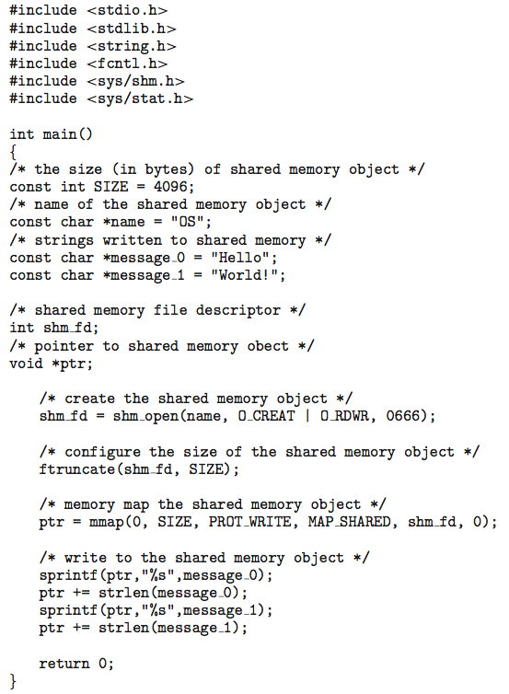
IPC POSIX Producer
Not in Syllabus

Slide 49
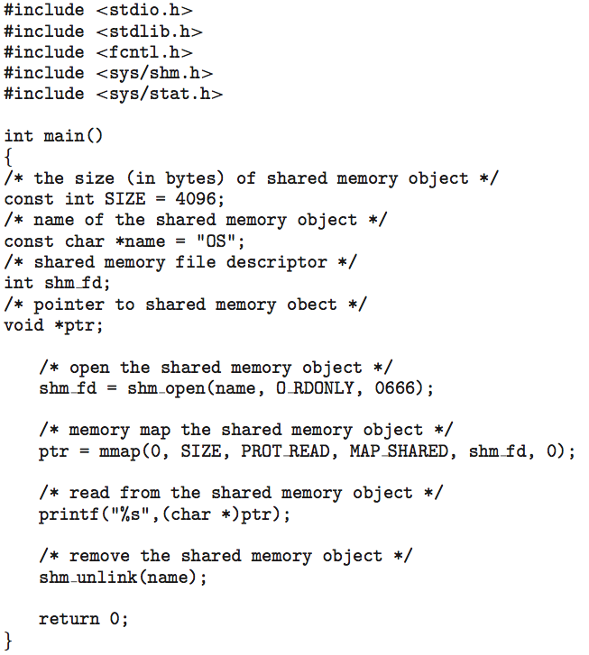
IPC POSIX Consumer
Not in Syllabus

Slide 50
Examples of IPC Systems - Mach
Not in Syllabus
Mach communication is message based
Even system calls are messages
Each task gets two mailboxes at creation- Kernel and Notify
Only three system calls needed for message transfer
msg_send(), msg_receive(), msg_rpc()
Mailboxes needed for commuication, created via
port_allocate()
Send and receive are flexible, for example four options if mailbox full:
Wait indefinitely
Wait at most n milliseconds
Return immediately
Temporarily cache a message

Slide 51
Examples of IPC Systems – Windows
Not in Syllabus
Message-passing centric via advanced local procedure call (LPC) facility
Only works between processes on the same system
Uses ports (like mailboxes) to establish and maintain communication channels
Communication works as follows:
The client opens a handle to the subsystem’s connection port object.
The client sends a connection request.
The server creates two private communication ports and returns the handle to one of them to the client.
The client and server use the corresponding port handle to send messages or callbacks and to listen for replies.

Slide 52
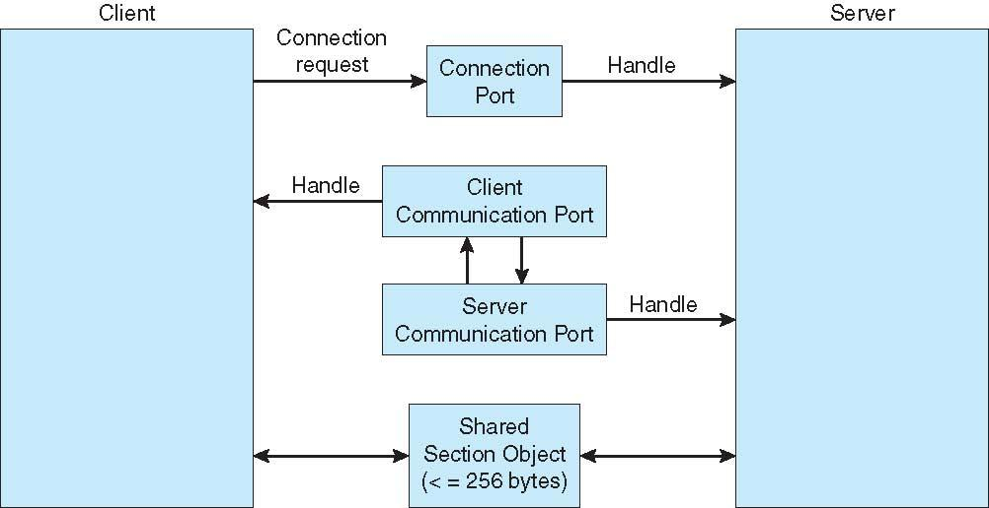
Local Procedure Calls in Windows
Not in Syllabus

Slide 53
Communications in Client-Server Systems
Not in Syllabus
Sockets
Remote Procedure Calls
Pipes
Remote Method Invocation (Java)

Slide 54
Sockets
Not in Syllabus
A socket is defined as an endpoint for communication
Concatenation of IP address and port – a number included at start of message packet to differentiate network services on a host
The socket 161.25.19.8:1625 refers to port 1625 on host 161.25.19.8
Communication consists between a pair of sockets
All ports below 1024 are well known, used for standard services
Special IP address 127.0.0.1 (loopback) to refer to system on which process is running

Slide 55
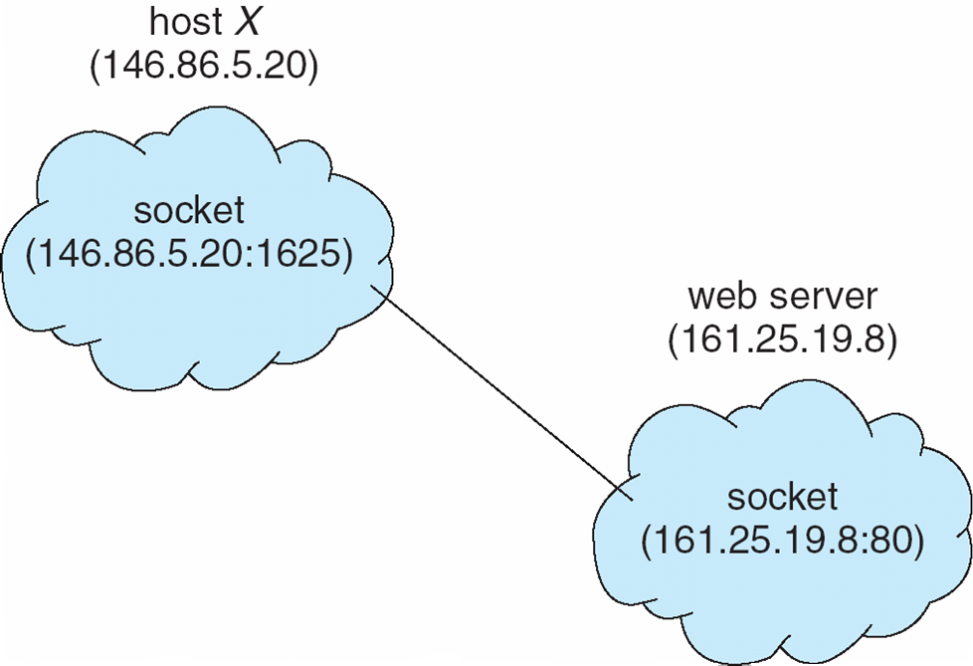
Socket Communication
Not in Syllabus

Slide 56
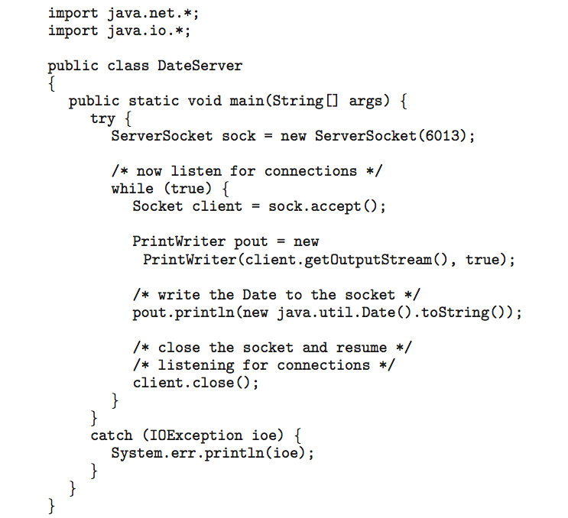
Sockets in Java
Not in Syllabus
Three types of sockets
Connection-oriented (TCP)
Connectionless (UDP)
MulticastSocket class– data can be sent to multiple recipients
Consider this “Date” server:

Slide 57
Remote Procedure Calls
Not in Syllabus
Remote procedure call (RPC) abstracts procedure calls between processes on networked systems
Again uses ports for service differentiation
Stubs – client-side proxy for the actual procedure on the server
The client-side stub locates the server and marshalls the parameters
The server-side stub receives this message, unpacks the marshalled parameters, and performs the procedure on the server
On Windows, stub code compile from specification written in Microsoft Interface Definition Language (MIDL)

Slide 58
Remote Procedure Calls (Cont.)
Data representation handled via External Data Representation (XDL) format to account for different architectures
Big-endian and little-endian
Remote communication has more failure scenarios than local
Messages can be delivered exactly once rather than at most once
OS typically provides a rendezvous (or matchmaker) service to connect client and server
Not in Syllabus

Slide 59
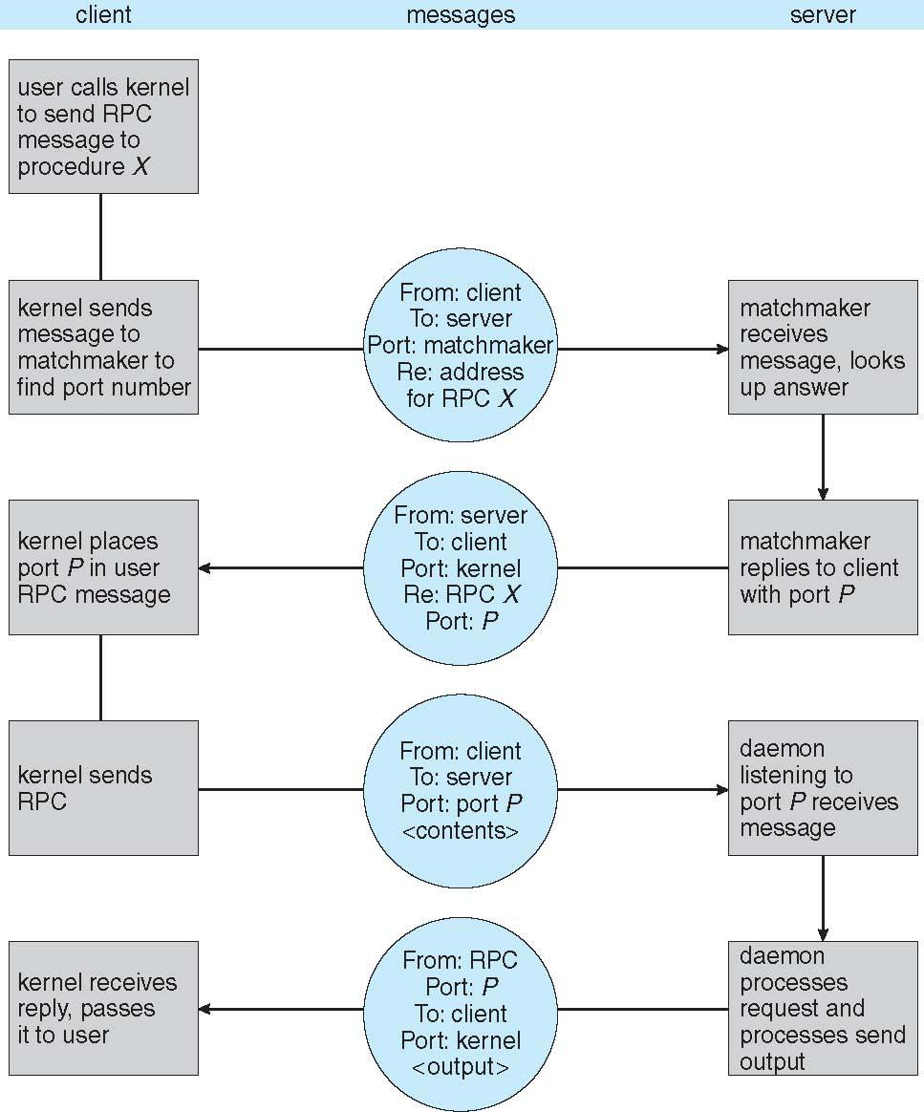
Execution of RPC
Not in Syllabus

Slide 60
Pipes
Not in Syllabus
Acts as a conduit allowing two processes to communicate
Issues:
Is communication unidirectional or bidirectional?
In the case of two-way communication, is it half or full-duplex?
Must there exist a relationship (i.e., parent-child) between the communicating processes?
Can the pipes be used over a network?
Ordinary pipes – cannot be accessed from outside the process that created it. Typically, a parent process creates a pipe and uses it to communicate with a child process that it created.
Named pipes – can be accessed without a parent-child relationship.

Slide 61
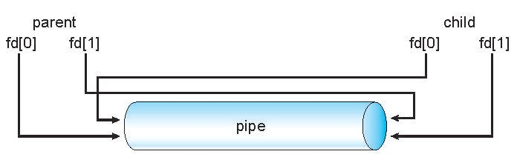
Ordinary Pipes
Not in Syllabus
Ordinary Pipes allow communication in standard producer-consumer style
Producer writes to one end (the write-end of the pipe)
Consumer reads from the other end (the read-end of the pipe)
Ordinary pipes are therefore unidirectional
Require parent-child relationship between communicating processes
Windows calls these anonymous pipes
See Unix and Windows code samples in textbook

Slide 62
Named Pipes
Not in Syllabus
Named Pipes are more powerful than ordinary pipes
Communication is bidirectional
No parent-child relationship is necessary between the communicating processes
Several processes can use the named pipe for communication
Provided on both UNIX and Windows systems

Slide 63
End of Chapter 3

